Slide 1
Standard 10.3
Students analyze the effects of the Industrial Revolution in England, France, Germany, Japan, and the United States.

Slide 2
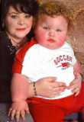
What were Social effects of the industrial revolution
In terms of social structure, the Industrial Revolution witnessed the triumph of a middle class.
Ordinary working people found increased opportunities for employment
Industrial workers were better paid than those in agriculture.
With more money, women ate better, had healthier babies, who were themselves better fed.

Slide 3
Child labor
Children were expected to work. Employers also liked that they could pay a child less than an adult.
The first law against child labor, the Factory Act of 1833.
Children younger than nine were not allowed to work,
children were not permitted to work at night
The work day of youth under the age of 18 was limited to twelve hours

Slide 4
Housing
Poor people lived in small houses in cramped streets. These homes would share toilet facilities, have open sewers and would be at risk of damp. Conditions did improve during the 19th century as public health acts were introduced covering things such as sewage, hygiene and making some boundaries upon the construction of homes. Not everybody lived in homes like these. The Industrial Revolution created a larger middle class of professionals such as lawyers and doctors. The conditions for the poor improved over the course of the 19th century because of government and local plans which led to cities becoming cleaner places, but life had not been easy for the poor before industrialization.

Slide 5
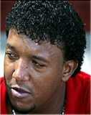
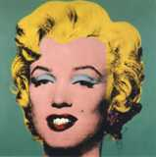
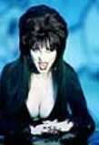
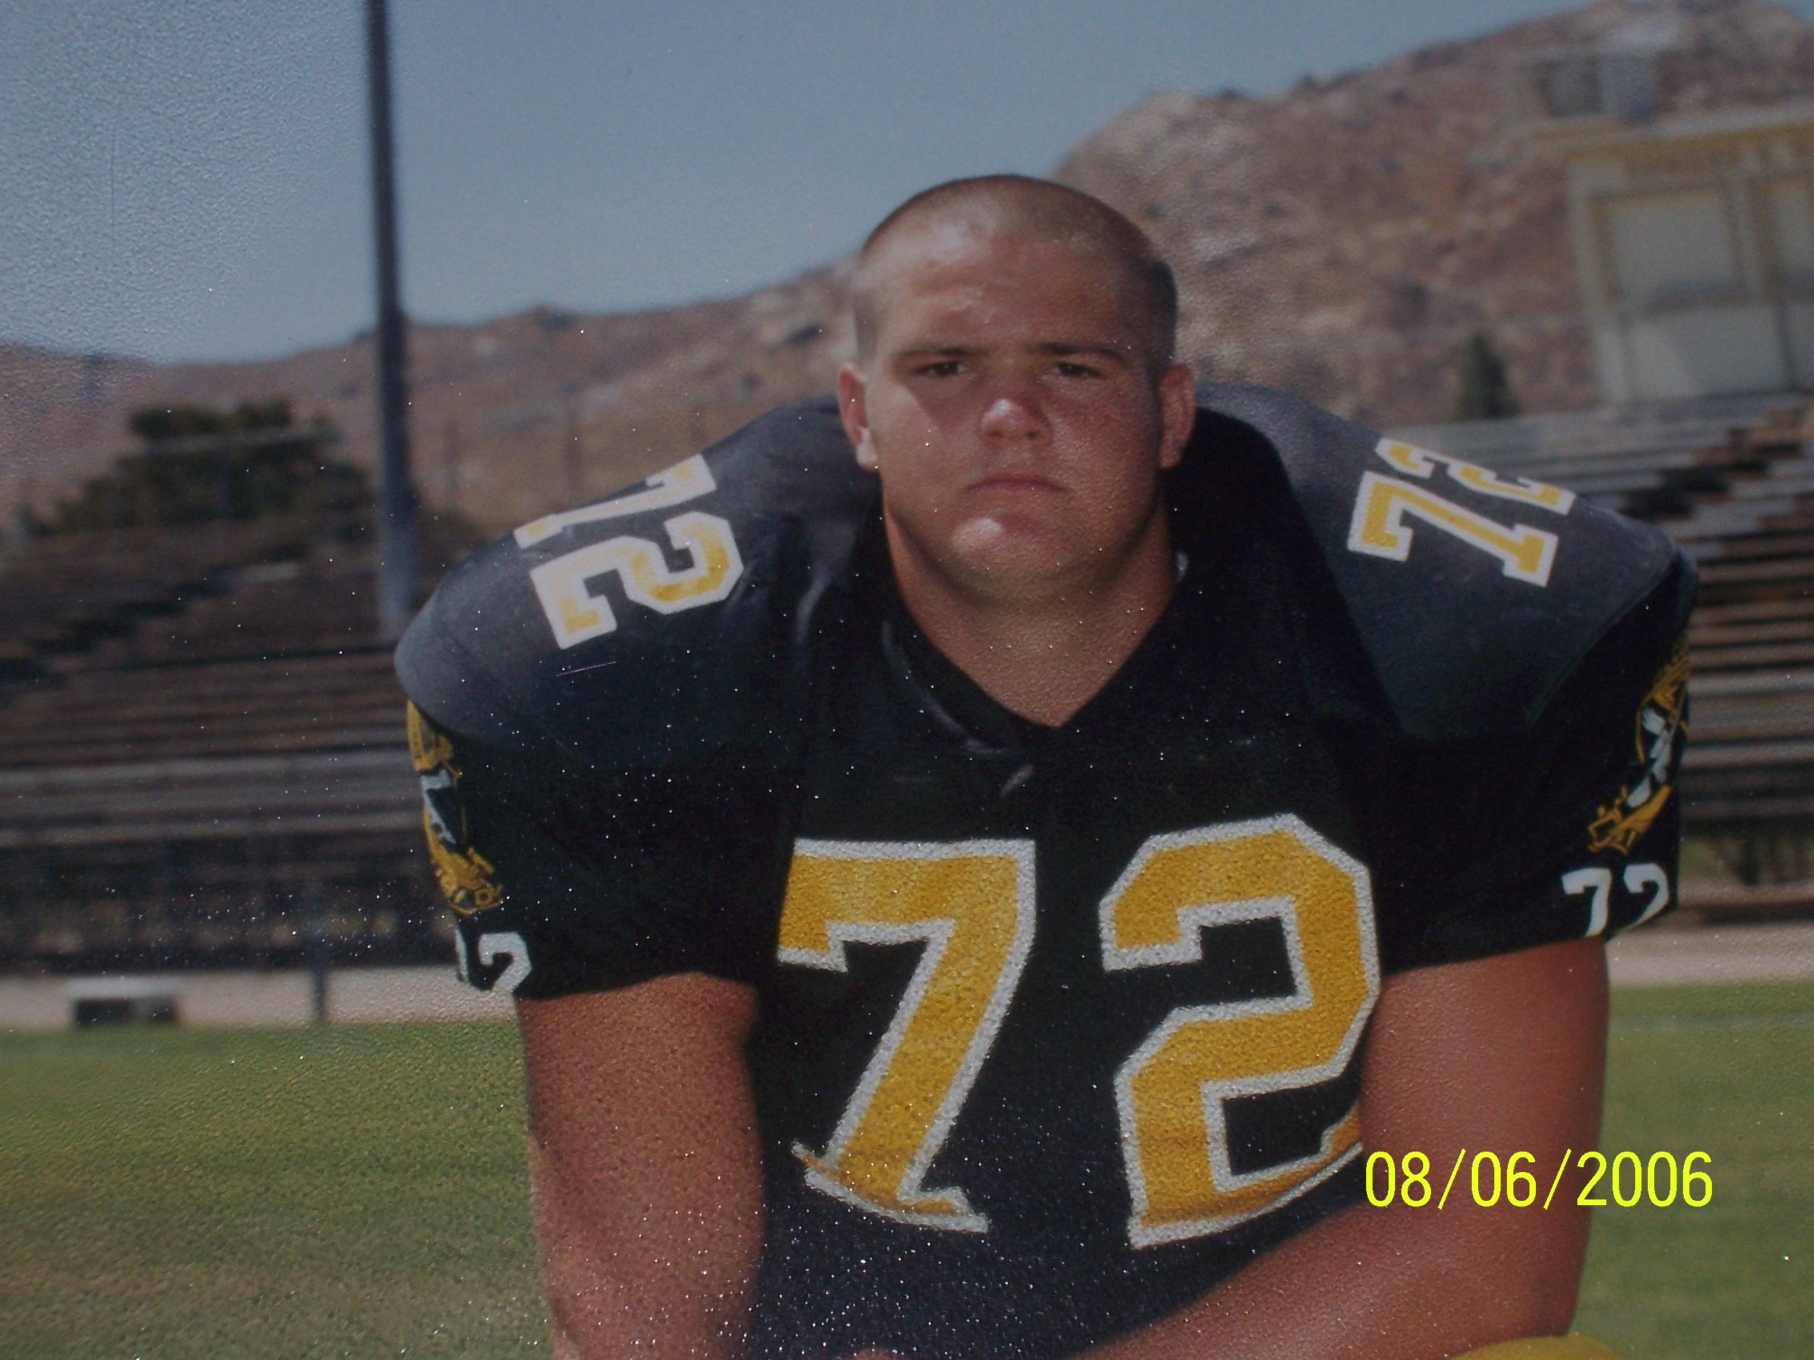
Popular culture

Slide 6
Popular culture
the culture of the people
It results from the daily interactions, needs and desires and cultural 'moments' that make up the everyday lives of the mainstream.
It can include any number of practices, including those pertaining to cooking, clothing, mass media and the many facets of entertainment such as sports and literature.
People like to feel a part of a group and to understand their cultural identity within that group, which tends to happen naturally in a small, somewhat isolated community.

Slide 7
This powerpoint was kindly donated to www.worldofteaching.com
http://www.worldofteaching.com is home to over a thousand powerpoints submitted by teachers. This is a completely free site and requires no registration. Please visit and I hope it will help in your teaching.

